Slide 1
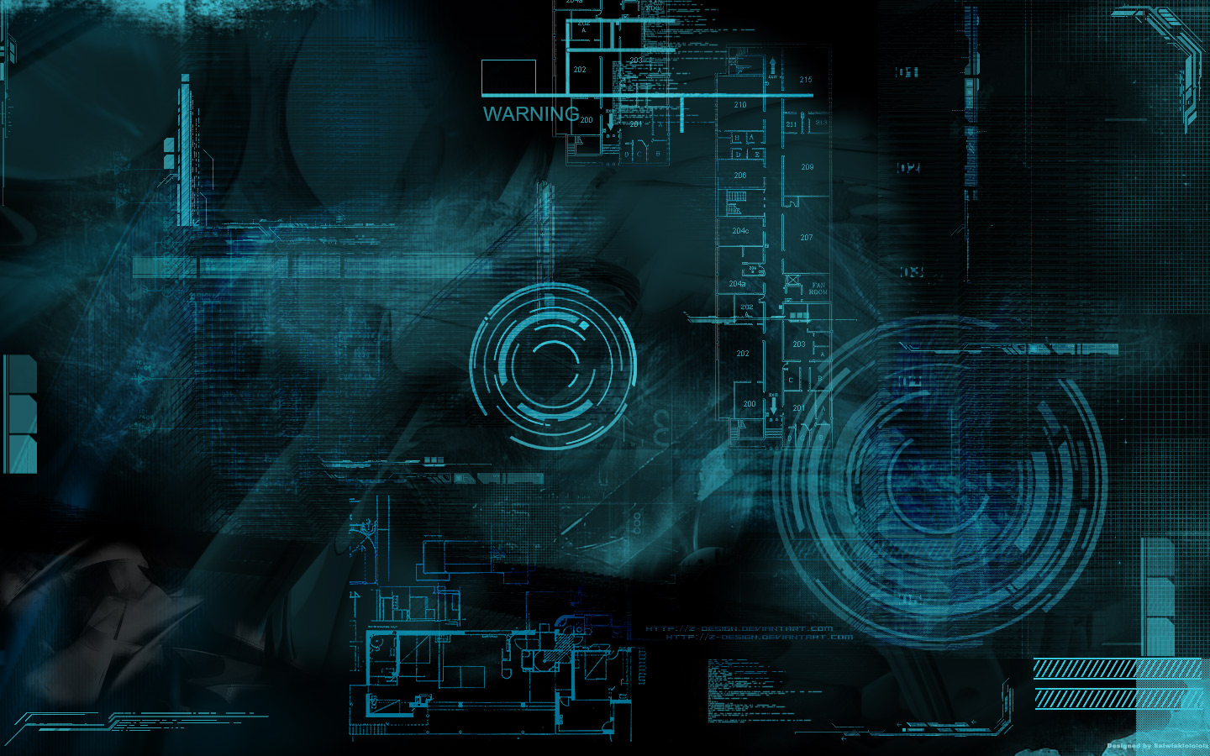
SUBTITLE REMOVAL FROM VIDEO

Slide 2


DECLARATION
I, Sruti Bhattacharjee, hereby, declare that this PowerPoint presentation is an authentic work being carried out by me under the guidance of Dr. Rajat Shubhra Chakraborty of Computer Science and Engineering Department, Indian Institute of Techno and is approved as final year project by Department of Information Technology of MCKV Institute of Engineering. I’m submitting this to Maulana Abul Kalam Azad University of Technology for as a work to get bachelor degree in Information Technology.
Sruti Bhattacharjee
IT/14/20
Roll No: 11600214049

Slide 3

OBJECTIVES
Removal of Hard Coded subtitles from a video
The video quality should be preserved after removing the subtitles
Explore basic Image Processing techniques and their limitations
Developing an user-friendly application to execute the task
Developing Inpainting Algorithm for region filling and replacement

Slide 4
CONTENTS
Introduction
Background and existing methods
Problem Description
Tools Used
Work Done
Frame Conversion Method (FCM)
Results of FCM
Application Developed
Challenges Faced
Can We Do Better?
Exemplar Based Inpainting
Inpainting Results and Challenges
Conclusion
Future Work
References

Slide 5
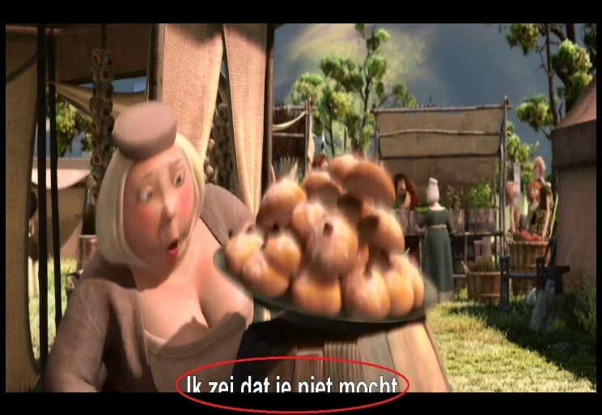
INTRODUCTION
Videos are one of the most popular learning and entertainment media
To make a video accessible to a wide range of culturally and linguistically diverse audience, we need subtitles in native language
But these subtitles are often hardcoded in a video and thus removing them while preserving the quality becomes a necessity
Apart from subtitles it also becomes necessary to remove watermark, logo and as such from a video

Slide 6
BACKGROUND AND EXISTING METHODS
Subtitles are of major two types- hardcoded and softcoded
The issue of removing hardcoded texts, watermarks, logos and time stamps have been dealt before and some very sophisticated soft wares exist
The use of machine learning algorithms have been used to extrapolate data
Inpainting algorithms have also been tried for region filling and replacement

Slide 7
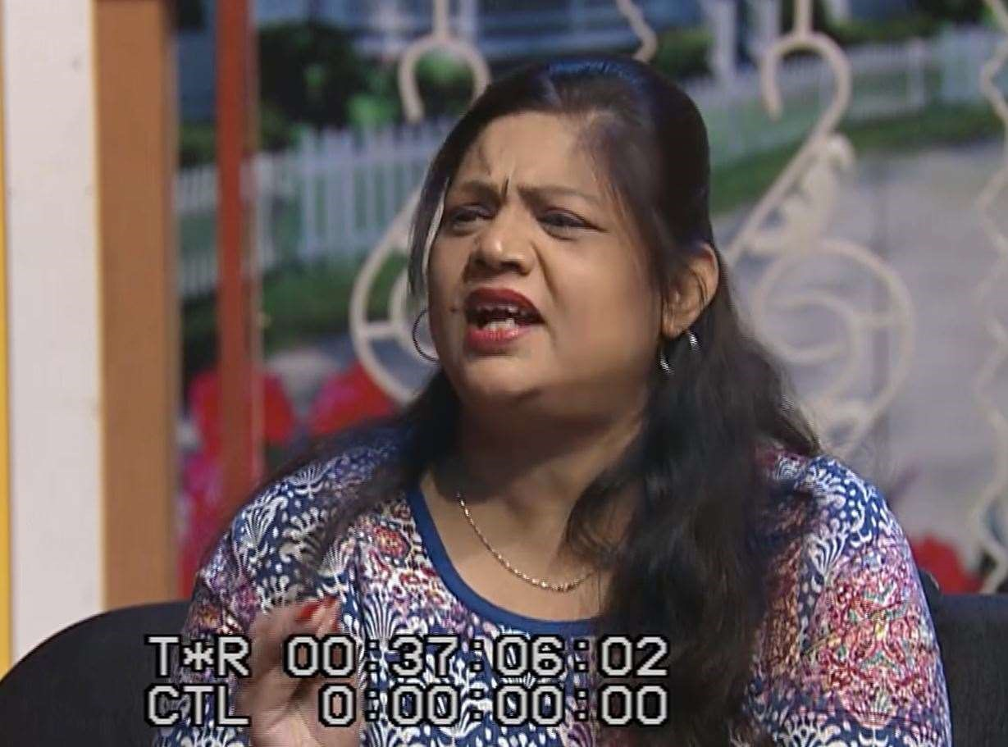
PROBLEM DESCRIPTION
Remove hardcoded texts from a video and obtain a clean image with no or minimal information loss
Below is a frame of the video which was the primary target of my project

Slide 8
TOOLS USED
This GUI based is built only using basic image processing techniques using MATLAB. Those who want to use it have to install MATLAB first. I implemented it using MATLAB 2016a. It is also supported in Visual Studio 2017 with the presence of necessary MATLAB libraries.

Slide 9
WORK DONE
We tried a few methods for achieving our tasks based on classic interpolation techniques modified for our use
The video was stored frame by frame and we applied frame conversion on it
Image processing was done on these frames for removal of subtitles
But the results were sometimes not very satisfactory, so we looked into Inpainting methods

Slide 10
FRAME CONVERSION METHOD (FCM)
The video was stored in a 3D matrix XYT, with the frames being along T axis
We applied frame conversion to obtain the YT 2D frames from the XYT matrix
The subtitles appeared as non-uniform bands of white and black
We applied various interpolation algorithms for removing and replacing the bands with information from background
The YT frames were taken and we revert back to the XYT matrix to constitute the whole video

Slide 11
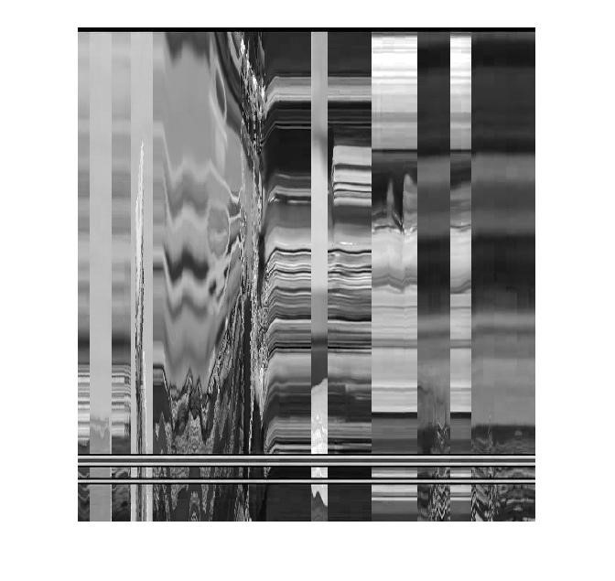
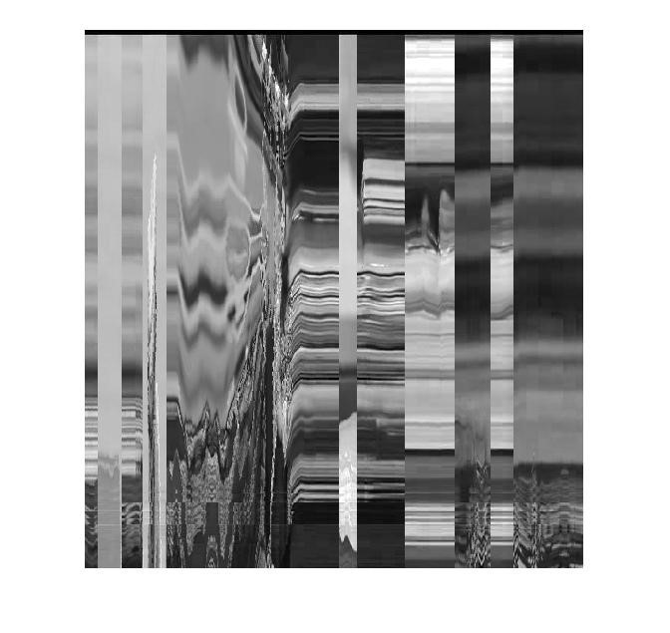
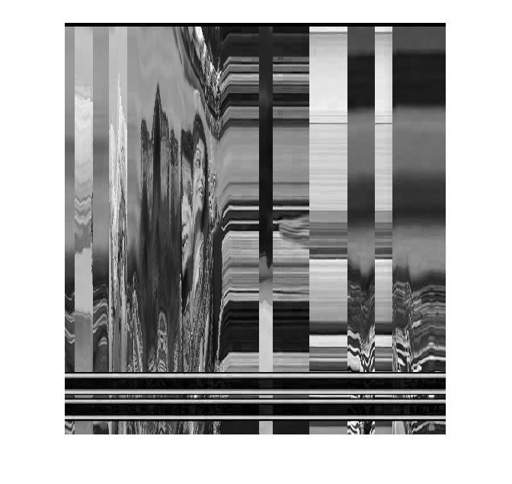
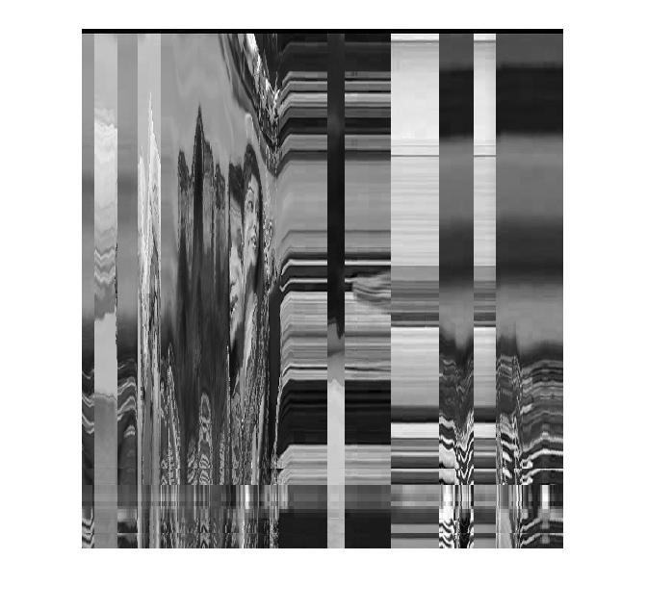
FRAME CONVERSION METHOD (FCM)
YT frames before and after applying interpolation algorithms
The 100th YT frame The 250th YT frame

Slide 12
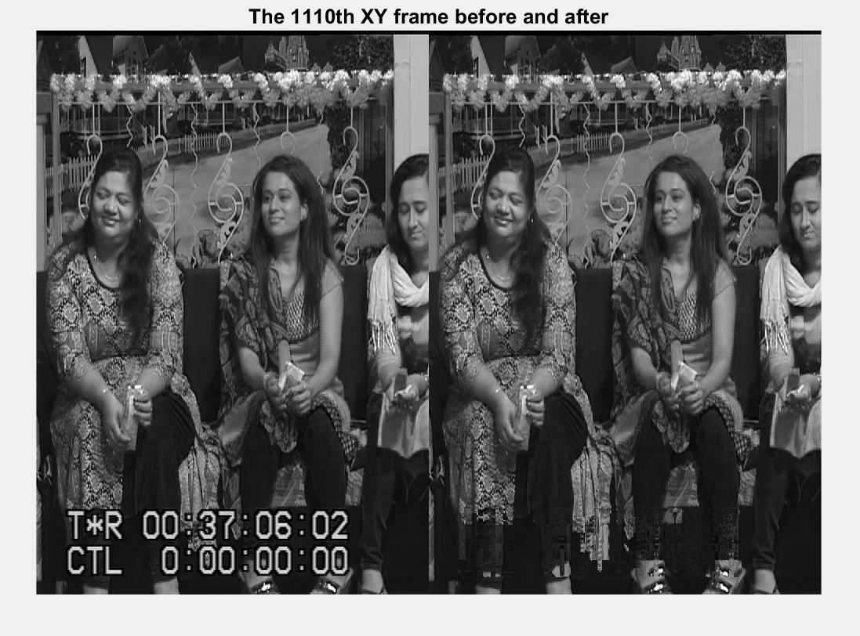
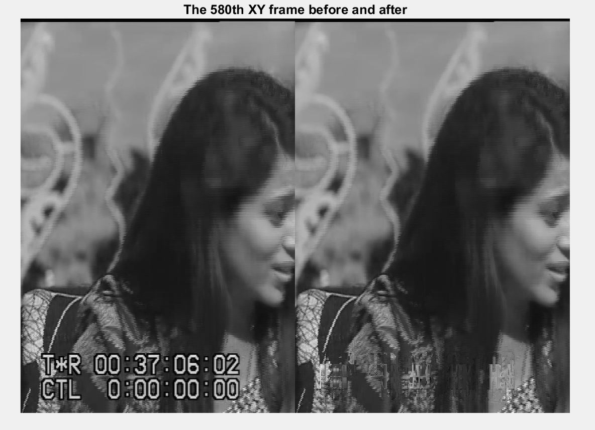
RESULTS OF FCM
SUCCESFUL RESULTS

Slide 13
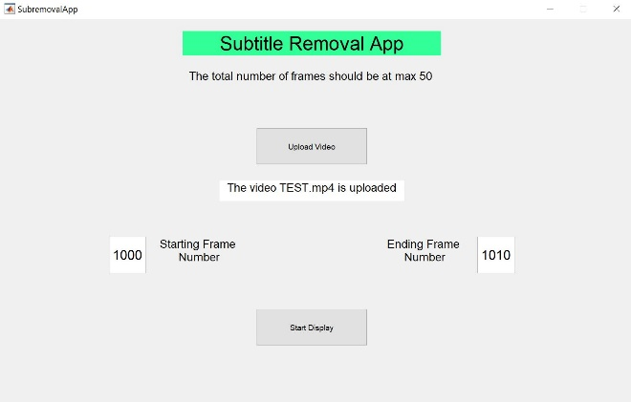
APPLICATION DEVELOPED BASED ON FCM
Application was built using MATLAB GUI

Slide 14
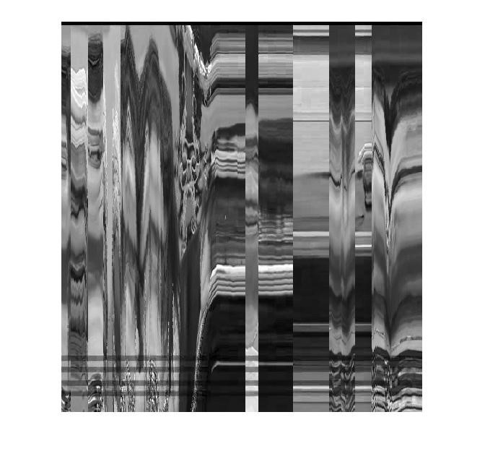

CHALLENGES FACED
The first and foremost problem was the non-uniformity of the subtitles. The subtitles were not uniform in either color intensities or shape
The bands obtained in the frame conversion method were difficult to identify, analyze and process on
Moreover the computation time was also huge and hence, I had to select a part of the video to process on
Also the size of the frames was large and for efficient computation, often the processing had to be done on the region which covered the subtitles
UNSUCCESFUL RESULT

Slide 15
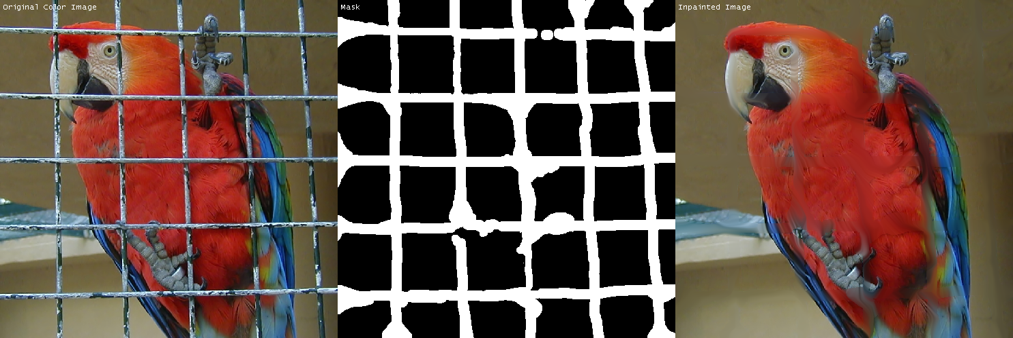
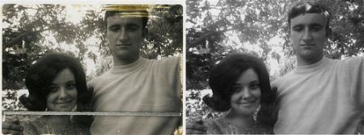
CAN WE DO BETTER?
Because of the limitations of FCM, we had to look for other techniques in Image Processing literature
Inpainting methods showed a lot of promise
‘Inpainting’ refers to the application of sophisticated algorithms to replace lost or corrupted parts of the image data (mainly small regions or to remove small defects)

Slide 16
EXEMPLAR BASED INPAINTING
Exemplar-based inpainting techniques, in general, remove objects by replacing them with a visually plausible backgrounds
The core of their algorithm is broken down into two parts
The first part fills holes in images by propagating linear structures into the target region; The intuition behind this techniques arises from the “Connectivity Principle” of vision psychology, which states that broken lines tend to be connected
The second part addresses composite textures - multiple textures interacting spatially
The idea behind this part is to fill in larger areas of an image by repeating the textures that surrounds the target region with some level of stochasticity

Slide 17
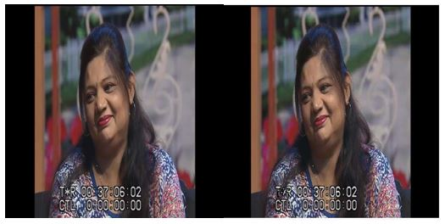
INPAINTING RESULTS AND CHALLENGES
The masks had to be drawn manually for all the objects i.e. the text letters so the task was rigorous
As the subtitles were not uniform, the objects were not properly connected, the results after applying were not satisfactory
The inpainting method had to be iterated multiple times and applying it on every frame was hugely time consuming as each iteration took an extensive computation time

Slide 18
CONCLUSION
Removal of hardcoded text from a video is necessary and an user-friendly application based on basic image processing techniques must be developed
Frame Conversion Methods gave satisfactory results in many cases but was limited by the non-uniformity and computational efficiency
Exemplar based inpainting showed promise but it gave unsatisfactory results due text type and was limited by its high computational complexity
We need to explore further techniques and preferably look more into how to make inpainting a success

Slide 19
FUTURE WORK
Develop a method for non-static subtitles or text i.e. texts which change from frame to frame in a video
Look into removing watermarks and logos from a video
Developing a new inapainting algorithm specialized around this particular problem which would give satisfactory results and be computationally efficient

Slide 20
REFERENCES
Haihong Li, Joanna Xu, Chen Zhu. In Proc Standford University. “Object/Defect Removal via Single-image Super-resolution on NLM-priority based Inpainting and Sparse Codin” Reference pages to explore
A. Criminist, P.Perez, K. Toyama. Microsoft Research, Cambridge, UK in Proc IEEE TRANSACTIONS ON IMAGE PROCESSING “Region Filling and Object Removal by Examplar-based Image Inpainting” Vol 13, Sep 2004 pp 2-4
R. Gonzalez and R. Woods. Addition-Wesley Publishing Company,1992. “Digital Image Processing” pp 415-416,pp-443-452
C.K.Chow and T.Kaneko. “Automatic Boundary detection of the left ventricle from Cineangiograms”,Comp. Biomed. Res (5).1972. pp 388-410
R.Boyle and R.Thomas. “Computer vision: a first course”Addition-Blackwell Scientific Publications, 1998, Ch-4
https://ocw.mit.edu./resources/res-18-002-introduction-to-matlab-spring-2008/lecture-notes/
MATHWORKERS. “Matlab Image Processing Toolbox” v-2016a, 2017.

Slide 21
Any Criticisms?
Any Questions?
THANK YOU FOR YOUR TIME!

